Slide 1
 | Completed Activities | Upcoming Activities for the Year
 | March Technical/Business Meeting was held on Thursday, 12th March, 2026 – Mr Alex Oshodi from JUVICLE Energy (Speaker) and Mr Emeka Ejika, FNAPE (Chairman). Over 200 people registered and over 148 participants (virtually). Membership Drive Continues: Prof Berti Ozumba, FNAPE paid for 50 annual dues of our students across the 8 universities in AOC (Feb. 2026) Prof. C.S. Nwajide donated 10 copies of his three recent books to the 9 (nine) Geoscience Departments within the jurisdiction of the NAPE AOC and his Alma Mater (UI) (Mar. 2026) 2026 NAPE-NAU Chapter organized a Virtual Academic Session Alert titled ‘When Geology Lies: Why “Perfect” Prospects Become Dry Wells – An Industry Perspective’ by Okpara Augustine Obiora (Geologist at A‑Z Seismic Consultants) (21st February 2026). NAPE Awka/Owerri Chapter lost two of her members in Feb 2026: Late Mr. Ugochukwu Elomba and Late Ms Chisom Achilihu | NAPE-AOC Reach out to Group of Secondary Schools across the 5 States in the southeast for NAPE Career Awareness in the Oil and Gas industries tagged ‘’Future Petroleum Explorationists’’(May 2026). May Technical/Business Meeting (Thursday, 14th May 2026) – Dr JohnBosco Onyeji (Geologist Chevron Nig. Ltd) July Technical/Business Meeting (Thursday, 9th July 2026) – Mr. Philip Ajaebili (Operation Geophysicist-Renaissance Africa Energy Company Ltd). August Technical/Business Meeting (Thursday, 13th August 2026) – Prof. K. K. Nwozor (Professor of Geophysics, COOU Nigeria). Encourage Schools to participate in AAPG-IBA & NAPE-BEC/ Organizing University Students Chapter Weeks/Visiting Guest Lecturer Program (UNIZIK, UNN, COOU, AE-FUNAI)

Slide 2

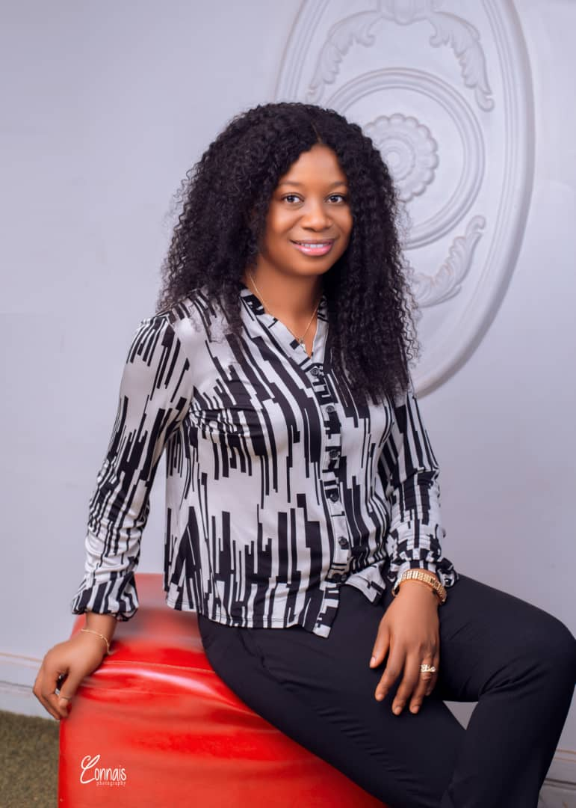
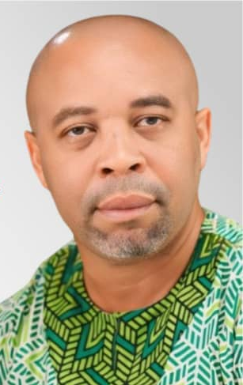
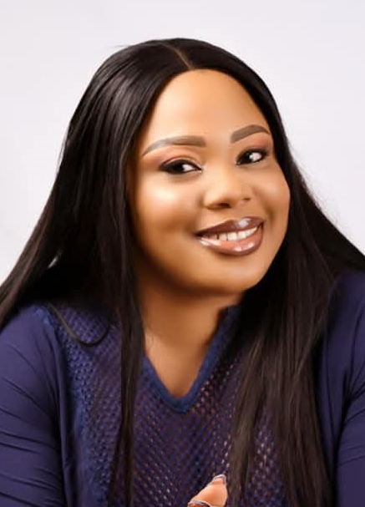
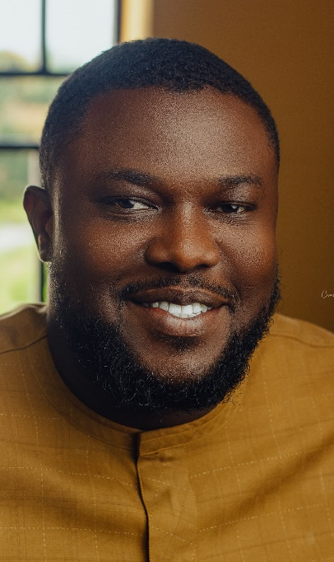
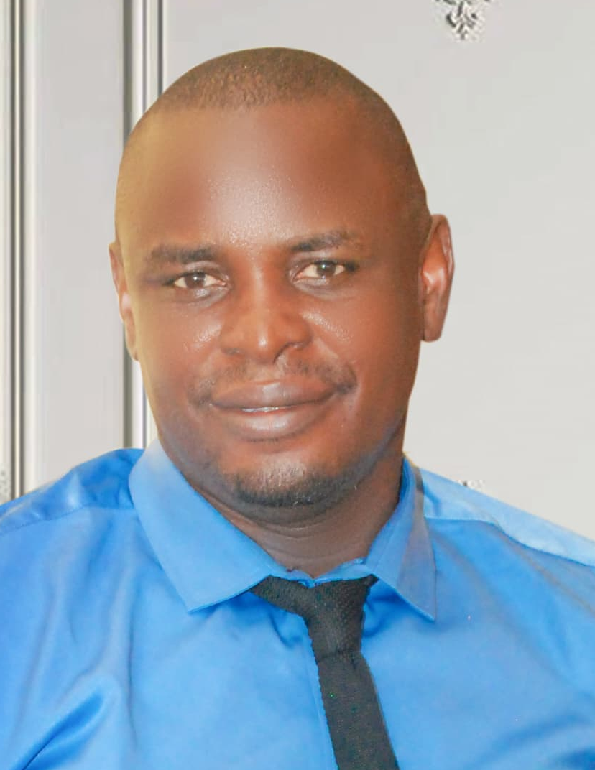
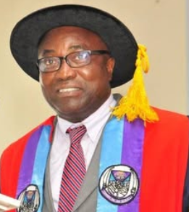
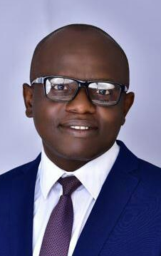
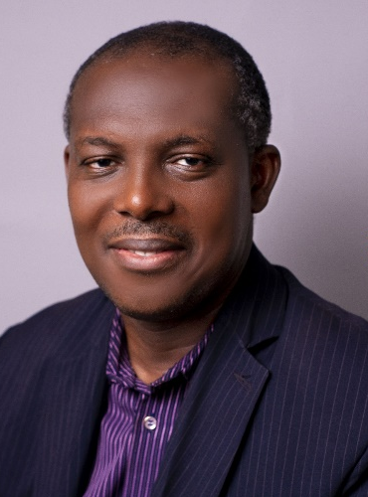
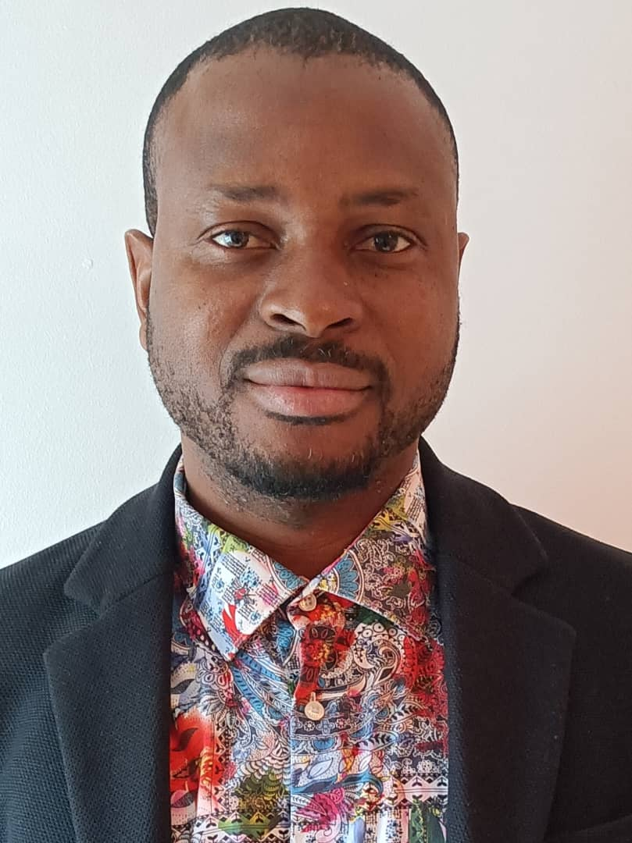
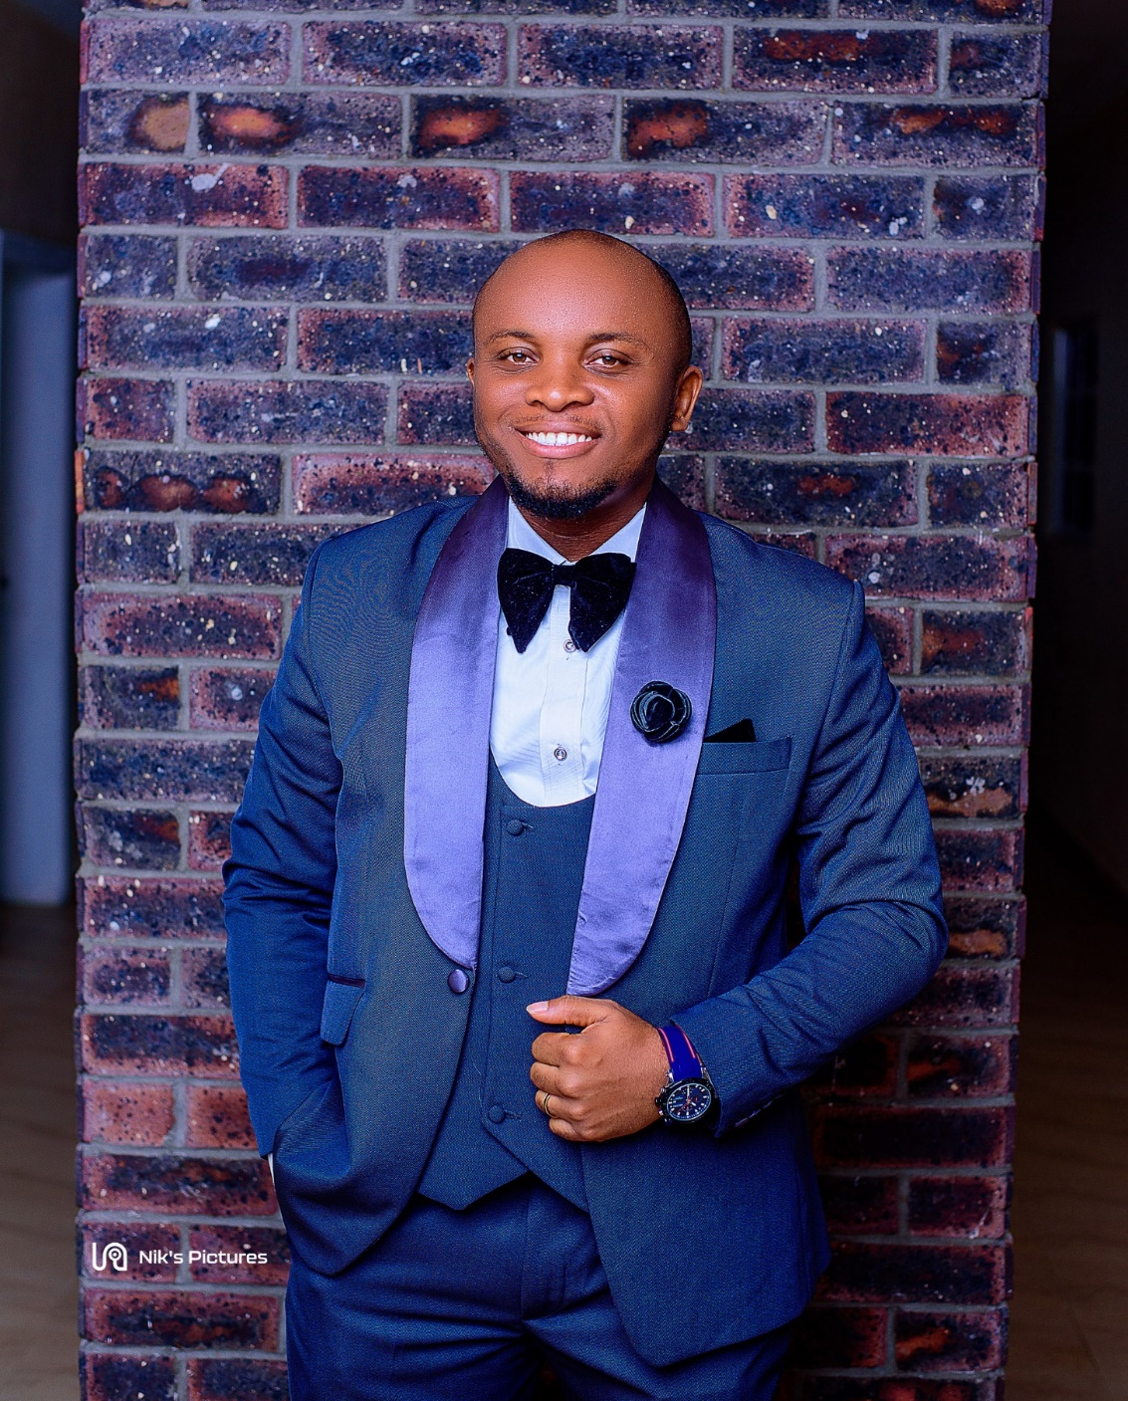
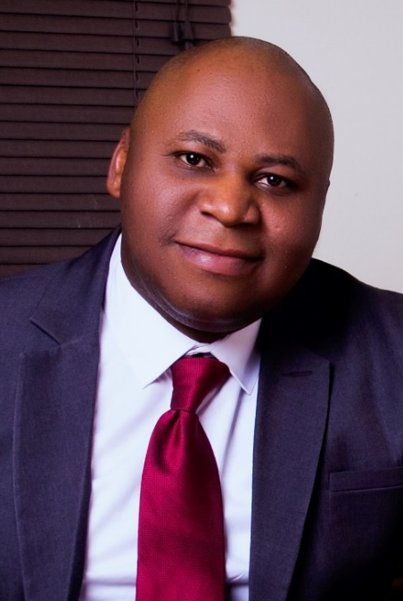
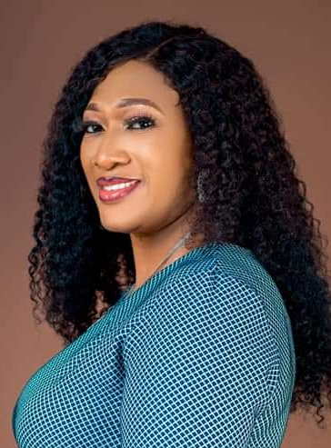
Awka/Owerri Chapter REPORT (1ST )
Meet Awka/Owerri Chapter Executive Members
Dr. Ifeanyi Chinwuko
Coordinator
Dr. Chioma Maduewesi
Deputy Coordinator
Dr. Sabinus Ibeneme
Secretary
Dr. Rita Orajiuka
Asst. General Secretary
Chibuzo Ahaneku
Publicity Secretary
Prof Bertram Ozumba
Advisory Council Nominee
Prof. Leonard Onuba
Technical Director
Dr. Austin Okonkwo
Treasurer
Dr. Chima Kelvin
Financial Secretary
George Okeke
YP Coordinator
    Dr. Princeton Dim
    Immediate Past Coord.
    Dr. Adaobi Okeke
    Immediate Past Dep. Coord:

Slide 3
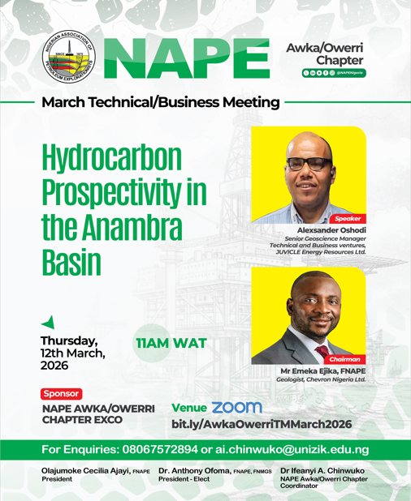
NAPE
CONTINUING EDUCATION SERIES 2026

Slide 4
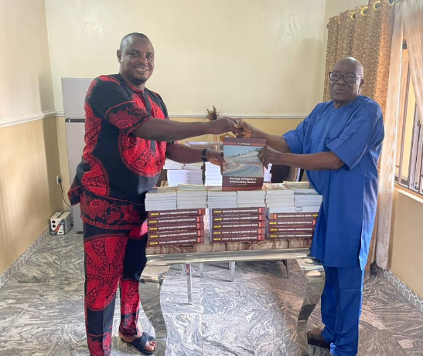
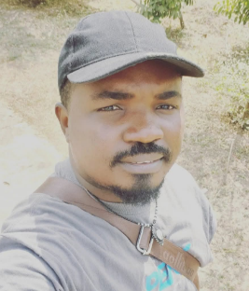
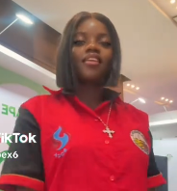
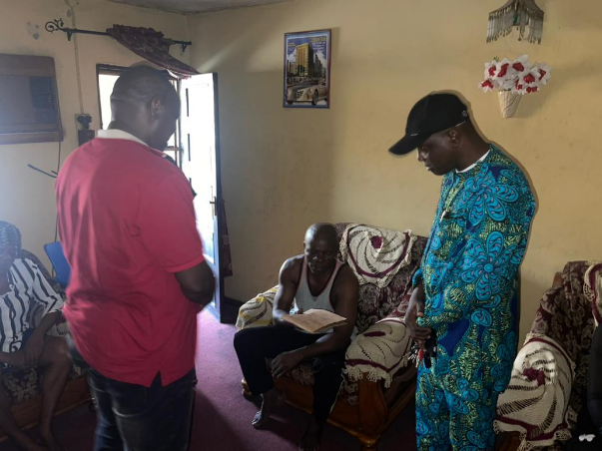
Late Mr. Ugochukwu Elomba Late Ms Chisom Achilihu
Prof Berti Ozumba, FNAPE Paid for 50 annual dues of our students across the 8 universities in AOC (Feb. 2026)
Prof C.S. Nwajide, FNAPE:
Donoted 10 copies of his three recent books to each of the 9 (nine) Geoscience Depts within the NAPE AOC and his Alma Mater (University of Ibadan
Condolence visit to Late Ms Chisom Achilihu:
Thanks to NAPE-YP

Slide 5


